Slide 1

Lecture 01
Mobile Cellular Network
By-
Jesmin Akhter
Associate Professor
Institute of Information Technology
Jahangirnagar University

Slide 2
Mobile Cellular Network
The concept of cellular network arises from cell.
Cell: Cell is the unit coverage of mobile cellular network. Geographic area is divided into cells, each serviced by an antenna and its associated radio equipment called base station (BS).

Slide 3
Cell and cell cluster
Concept of mobile cellular communication system has arises from cell.
Cell: Cell is the unit coverage of mobile cellular network. Geographic area is divided into cells, each serviced by an antenna and its associated radio equipment called base station (BS).
The hexagonal cells are arranged in a continuous fashion to cover the entire service.
Hexagonal cell

Slide 4
Basic of Mobile Cellular Network
Break the metropolitan area into small areas
Each area is approximated with a hexagonal cell.
A base station is located at the center of each cell.
Each cell is assigned only a fraction of the total number of channels.
Cells that are sufficiently far apart can reuse the same frequency.

Slide 5
Hexagonal Cells in a continuous fashion

Slide 6
Why Hexagonal Cell?
Hexagonal-shaped communication cells are artificial and that such a shape cannot be generated in the real world. Engineers draw hexagonal-shaped cells on a layout to simplify the planning and design of a cellular system because it approaches a circular shape that is the ideal power coverage area. The circular shapes have overlapped areas which make the drawing unclear. The hexagonal shaped cells fit the planned area nicely with no gap and on overlap between the cells. The real cell has irregular shape because of natural, and man made obstacle in service area.

Slide 7
Cell Shape
R
R
R
Cell
R
R
(a) Ideal cell
(b) Actual cell
(c) Different cell models
Factitious

Slide 8
Factitious
Idealized Coverage
Footprint
Reality!

Slide 9
Basic Mobile Cellular Communication System
Cell phones communicate with Base Station over wireless links, called the ‘air interface’.
Base Stations connected to MTSO/MSC to switch calls to/from cell phone users
The base station is the bridge between the mobile users and the MSC via telephone lines or microwave links. Mobile Switching Center (MSC) controls several BSs and serves as gateway to the backbone network (PSTN, ISDN, Internet).
The Mobile Telephone Switching Office (MTSO)
Integrated Services Digital Network(ISDN)
public switched telephone network (PSTN)
Notes:
The Mobile Telephone Switching Office (MTSO) is the mobile equivalent to a PSTN Central Office. The MTSO contains the switching equipment or Mobile Switching Center (MSC) for routing mobile phone calls. It also contains the equipment for controlling the cell sites that are connected to the MSC.
ISDN telephone. Integrated Services Digital Network(ISDN) is a set of communication standards for simultaneous digital transmission of voice, video, data, and other network services over the traditional circuits of the public switched telephone network.

Slide 10



MSC
PSTN
Mobile cellular network

Slide 11
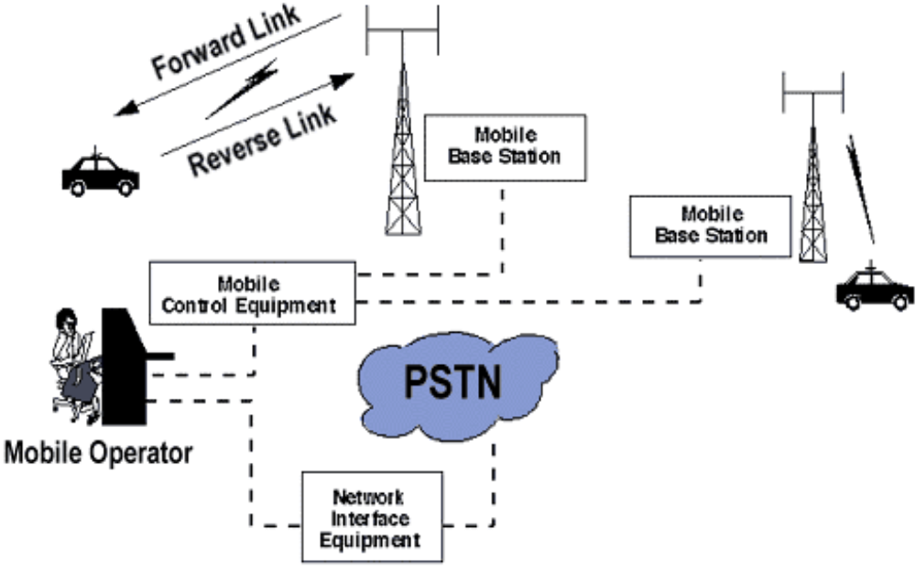
Structure of a Mobile Communication System

Slide 12
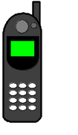
f₁
MS
MS
Antenna
Splitter
1:8
f₂
LNA
Duplexer
T_{x}
High capacity
data link
Duplexer
MTSO
A/D
FM (f₁)
Demodulator
R_{x}
PA
D/A
FM (f₂)
Modulator
Combiner
High capacity
data link
Radio Base Station (RBS)
A low-noise amplifier (LNA) is an electronic amplifier that amplifies a very low-power signal without significantly degrading its signal-to-noise ratio
Notes:
A low-noise amplifier (LNA) is an electronic amplifier that amplifies a very low-power signal without significantly degrading its signal-to-noise ratio
Modulation is nothing but, a carrier signal that varies in accordance with the message signal. Modulation technique is used to change the signal characteristics
Modulation techniques are methods that are used to encode digital information in an analog world. The 3 basic modulation techniques are as follows: AM (amplitude modulation) FM (frequency modulation) PM (phase modulation)

Slide 13
Cellular Spectrum
Phone Transmit
824
825
835
845
846.5
849
A band
10 MHz
333 channels
30khz
B band
10 MHz
333 channels
30khz
A” band
A’ band
B’ band
1 MHz
33 chan
1.5 MHz
50 chan
2.5 MHz
83 chan
20 MHz Guard
Base Transmit
869
870
880
890
891.5
894
A band
10 MHz
333 channels
30khz
B band
10 MHz
333 channels
30khz
A” band
A’ band
B’ band
1 MHz
33 chan
1.5 MHz
50 chan
2.5 MHz
83 chan

Slide 14
Cell Clusters
Service areas are normally divided into clusters of cells to facilitate system design and increased capacity.
Cell clusters are used in frequency planning for the network
The pattern of cluster is repeated throughout the network.
Entire BW is used within a cluster.
Coverage area of cluster called a ‘footprint’

Slide 15
Definition
Cells in a cellular network are generally “grouped” together into cell clusters. Cellular networks are generally designed as a repeated cluster pattern The number of cells in a cluster (typically 4,7, 12 or 21) is a trade-off between the traffic capacity in the cluster and its interference with the adjacent cluster of cells (where the same frequencies will be re-used)

Slide 16
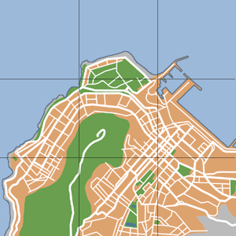
2
3
7
2
1
3
7
4
6
1
2
5
4
6
3
7
2
5
1
3
7
2
4
6
1
3
7
5
4
6
1
2
5
4
6
3
7
2
5
1
3
7
4
6
1
5
4
6
5

Slide 17
Frequency Reuse
Cluster-2
2
2
1
5
Cluster-1
1
5
4
4
3
7
3
7
6
6
2
1
5
N = 7
4
3
7
6
Cluster-3

Slide 18
Cell Pattern N = 4
2
1
3
2
4
2
1
3
1
3
4
2
4
1
3
4

Slide 19
Frequency Reuse Distance
The minimum distance which allows the same frequency to be reused will depend on many factors such as the number of co-channel cells in the vicinity of the center cell, the type of geographic terrain contour, antenna height and the transmitted power at each cell site.

Slide 20
Frequency Reuse
F7
F2
F7
F2
F6
F1
F3
F1
F6
F1
F3
F1
F5
F4
F7
F2
F5
F4
F7
F2
F6
F1
F3
F1
F6
F1
F3
F1
F5
F4
Reuse distance D
F5
F4
7 cell reuse cluster

Slide 21

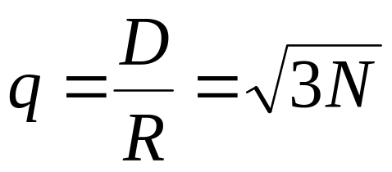
Reuse Distance
R
Cluster
For hexagonal cells, the reuse distance is given by
F7
F2
F6
F1
F3
F1
where R is cell radius and N is the reuse pattern (the cluster size or the number of cells per cluster).
F5
F4
F7
F2
F3
Reuse factor is
F6
F1
F1
Reuse distance D
F5
F4

Slide 22
Determine two parameters i and j, called shift parameters
Starting from any cell, move i cells along any one of the six emanating chains of hexagons. Turn clock (or counter clock)-wise by 60 degree and then move j cells along the chain. The destination is the nearest co-channel cell
By repeating this pattern, clusters of cells are formed such that each cell within a cluster is assigned a different set of frequencies. Such a cluster is called a frequency reuse pattern.

Slide 23
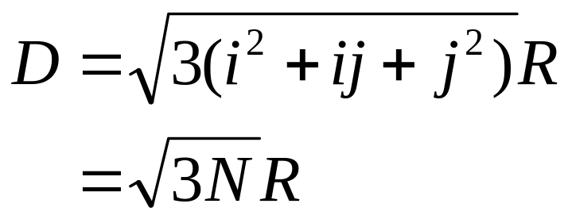
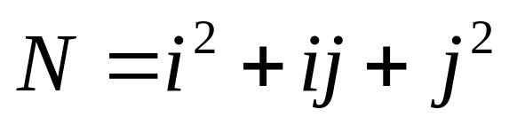

Example-2
where
Reuse factor
i = 2, j = 1
Note: i and j are integers
=7

Slide 24

Example-1
A
A
A
A
A
A
A
Shift Parameter: i = 3, j = 2
= 19

Slide 25
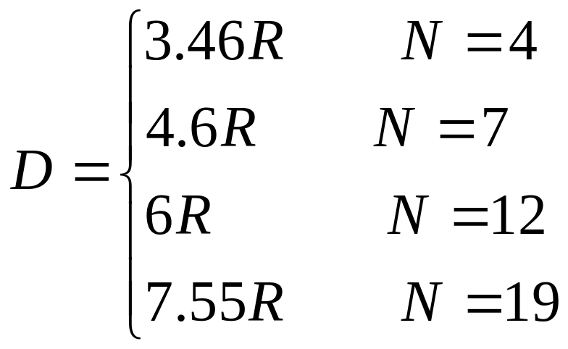
If all the cell sites transmit the same power then N increases and the frequency reuse distance D increases. This increased D reduces the chance that the co-channel interference may occur. Theoretically a large N is desired. However the total number of allocate channel is fixed. When N is too large, the number of channel assigned to each of N cells becomes small and carried traffic of that cell will be smaller.

Slide 26
Interferences In Mobile Cellular Network
Co-site Channel Interferences
Adjacent Channel Interferences
Co-channel Channel Interferences

Slide 27
Co-site Channel Interferences
Mutual interferences created by the users inside a cell is called co-site channel interferences. Since users are very closed in cell therefore separation between carries within a cell should be wide enough to avid interferences. At the same time uplink and down link carriers of an user are separated by 45MHz.

Slide 28
Co-channel Interferences
Interferences created by the users of two co-channel cells are called co-channel interferences. Because of use of same carries, huge interference is created despite of long distance between to co-cell. The distance between co-cell increases with increase in N, the of cells in a cluster.
Co-channel and adjacent channel interferences can be reduced using sectored cells.

Slide 29
Adjacent Channel Interferences
Interferences created by the users of two adjacent cells are called adjacent channel interferences. Because of small distance between adjacent cells an wide band gap should be maintained between carries of adjacent cell to avoid interferences.

Slide 30
Co-channel Interference
Determine the minimum distance at which a frequency can be reused with no interference, called the co-channel reuse distance (D).
Signal-to-interference ratio, (C / I), is an index of channel interference.
A
A
A
A
A
A
A
Shift Parameter: i = 3, j = 2

Slide 31
First tier co-channel Base Station
Second tier co-channel Base Station
R
D₆
D₅
D₁
D₄
Mobile Station
D₂
D₃
Serving Base Station

Slide 32
Worst Case of Co-channel Interference
D₆
R
D₅
D₁
Mobile Station
D₄
D₂
D₃
Serving Base Station
Co-channel Base Station

Slide 33
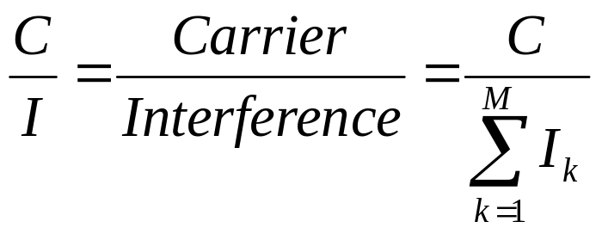
Co-channel Interference
Co-channel interference ratio is given by
where I is co-channel interference and M is the maximum number of co-channel interfering cells. We know,
C α R^{-γ}
Therefore C=K. R^{-γ;} where K is a constant and γ is path loss slope,
γ = 2~5, Similarly, I_{k} = K. D_{k}^{-γ}
For M = 6, C/I is given by,
C
1
=
I
⎛
−γ
M
D
⎞
∑
⎜
⎟
k
⎝
R
⎠
k
=
1

Slide 34
Thank You

Slide 35
TYPES OF TRANSMISSION MODE
Simplex Transmission Mode.
Half Duplex Transmission Mode
Full Duplex Transmission Mode.

Slide 36
SIMPLEX MODE
In simplex mode transmission information sent in only one direction.
Device connected in simplex mode is either sent only or received only that is one device can only send, other device can only receive.
Communication is unidirectional.

Slide 37
HALF DUPLEX
In half duplex transmission data can be sent in both the directions, but only in one direction at a time.
Both the connected device can transmit and receive but not simultaneously.
When one device is sending the other can only receive and vice-versa.

Slide 38
FULL DUPLEX
In full duplex transmission, data can be sent in both the directions simultaneously.
Both the connected devices can transmit and receive at the same time.
Therefore it represents truly bi-directional system.
In full duplex mode, signals going in either
Direction share the full capacity of link.

